Slide 1
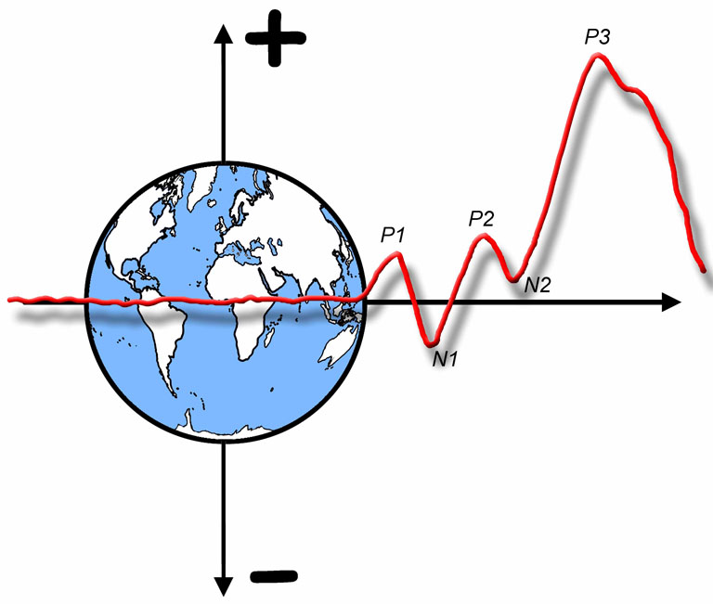

The ERP Boot Camp
Artifact Detection and Rejection

Slide 2
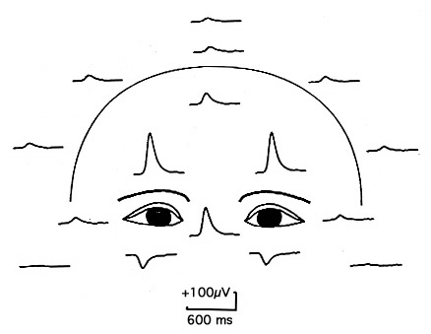
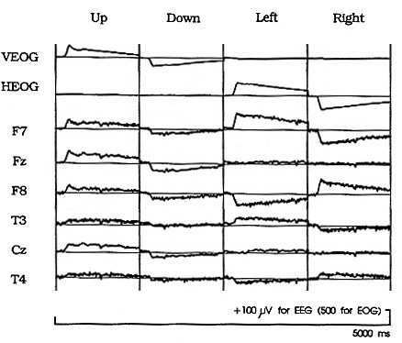
Ocular Artifacts
Noncephalic reference
Lins, Picton, Berg, & Scherg (1993)
Notes:
Figure 3 and Figure 4 Lins, Picton, Berg, Scherg (1993) Ocular artifacts in recording EEGs and event-related potentials. I: Scalp Topography. Brain Topography 6,1. 51-63. Reprinted with permission from Springer. © Springer. This material may be used for nonprofit research and education purposes only, and it may not be reprinted or distributed in any form including print and electronic forms.

Slide 3
Artifact Rejection: Why?
Reason 1: Noise reduction
Artifacts are a large noise signal
Reason 2: Control sensory input
Subject may not have eyes open or directed at stimuli
Reason 3: Systematic distortion of data
If subjects blink more for some kinds of stimuli than others, this will create a large artifact in the averaged ERPs
Same for vertical eye movements
Horizontal eye movements can distort N2pc and LRP
Artifact correction can deal with #1 and #3 but not #2
We will discuss artifact correction later
Notes:
© S. J. Luck. All Rights Reserved. May be used for nonprofit educational purposes if this copyright notice is included. Permission must be obtained from the copyright holder(s) for any other use.

Slide 4
Artifact Rejection: How?
Goal: Throw out trials with problematic artifacts; don’t throw out “good” trials
Throw out all channels if an artifact is detected in any channel
Problem: There is a continuum of “goodness”
Signal detection problem
Notes:
© S. J. Luck. All Rights Reserved. May be used for nonprofit educational purposes if this copyright notice is included. Permission must be obtained from the copyright holder(s) for any other use.

Slide 5
Artifact Rejection: How?
Goal: Throw out trials with problematic artifacts; don’t throw out “good” trials
Throw out all channels if an artifact is detected in any channel
Problem: There is a continuum of “goodness”
Signal detection problem
We have a measure of strength of artifact
Tends to be bigger when artifact is actually present
A good measure is big for present, small for absent
We set a rejection threshold
Any trials that exceed this threshold are thrown away
Best threshold depends on relative costs of misses and false alarms
Notes:
© S. J. Luck. All Rights Reserved. May be used for nonprofit educational purposes if this copyright notice is included. Permission must be obtained from the copyright holder(s) for any other use.

Slide 6
Changing the Threshold
To optimize artifact rejection, we need a measure that is tailored for the kind of artifact we are trying to reject; this requires knowing something about the artifacts
Rejected
Rejected
Not Rejected – False Negative
Rejected
Not Rejected
Not Rejected
Not Rejected
Rejected – False Positive
Notes:
Adapted from Figure 6.1 in Luck, S.J. (2014). An Introduction to the Event-Related Potential Technique, Second Edition. Cambridge, MA: MIT Press. © MIT Press.
This material may be used for nonprofit research and education purposes only, and it may not be reprinted or distributed in any form including print and electronic forms.

Slide 7
Blink Shape and Propagation
Active: Under Eye
Reference: Rm
Common to use VEOG-lower minus VEOG-upper
Notes:
Figure 4.8 from Luck, Steven J. (2005). An introduction to the Event-Related Potential Technique. Cambridge, MA: MIT Press.© MIT Press. This material may be used for nonprofit research and education purposes only, and it may not be reprinted or distributed in any form including print and electronic forms.

Slide 8
Absolute Threshold and Baseline Correction
Before Baseline Correction
After Baseline Correction
Notes:
Adapted from Figure 6.1 in Luck, S.J. (2014). An Introduction to the Event-Related Potential Technique, Second Edition. Cambridge, MA: MIT Press. © MIT Press.
This material may be used for nonprofit research and education purposes only, and it may not be reprinted or distributed in any form including print and electronic forms.

Slide 9
Peak-to-Peak Amplitude
Peak-to-peak amplitude:
Difference between most positive and most negative voltage in the rejection window
Notes:
Adapted from Figure 6.1 in Luck, S.J. (2014). An Introduction to the Event-Related Potential Technique, Second Edition. Cambridge, MA: MIT Press. © MIT Press.
This material may be used for nonprofit research and education purposes only, and it may not be reprinted or distributed in any form including print and electronic forms.

Slide 10
Moving Window Peak-to-Peak
Moving window
peak-to-peak amplitude:
Find biggest peak-to-peak amplitude in several small, overlapping windows
Takes advantage of the fact that a blink occurs over a period of about 200 ms
Notes:
Adapted from Figure 6.1 in Luck, S.J. (2014). An Introduction to the Event-Related Potential Technique, Second Edition. Cambridge, MA: MIT Press. © MIT Press.
This material may be used for nonprofit research and education purposes only, and it may not be reprinted or distributed in any form including print and electronic forms.

Slide 11
Minimizing Blinks
No contact lenses
Frequent breaks
Times when blinks are OK
But be careful of blink offsets
Notes:
© S. J. Luck. All Rights Reserved. May be used for nonprofit educational purposes if this copyright notice is included. Permission must be obtained from the copyright holder(s) for any other use.

Slide 12
Assessing Success
Was blink rejection successful?
Look for polarity inversions
Baseline impacted by blinks in this example
Experimental effect not due to blinks
Notes:
© S. J. Luck. All Rights Reserved. May be used for nonprofit educational purposes if this copyright notice is included. Permission must be obtained from the copyright holder(s) for any other use.

Slide 13
Saccadic Eye Movements
Step Function: Find largest difference in mean voltage between consecutive 100-ms time intervals
Active: HEOG-L
Reference: HEOG-R
Eyes contain dipole with positive end pointing toward front of eye
Amplitude linearly related to size of eye movement (16 µV/degree)
Notes:
Adapted from Figure 4.9 inLuck, Steven J. (2005). An introduction to the Event-Related Potential Technique. Cambridge, MA: MIT Press.© MIT Press. This material may be used for nonprofit research and education purposes only, and it may not be reprinted or distributed in any form including print and electronic forms.

Slide 14

Fixation Point
Best fixation point
Empirically demonstrated to minimize dispersion and microsaccades
Thaler, Lore, Schütz, Alexander C, Goodale, Melvyn A, & Gegenfurtner, Karl R. (2013). What is the best fixation target? The effect of target shape on stability of fixational eye movements. Vision Research, 76, 31-42.
Usually best for the fixation point to be continuously visible
Otherwise you get an onset response to the fixation point
But brief disappearance of fixation point can be a good way to signal the time period in which blinks are allowed
Notes:
© S. J. Luck. All Rights Reserved. May be used for nonprofit educational purposes if this copyright notice is included. Permission must be obtained from the copyright holder(s) for any other use.

Slide 15
Minimizing and Detecting Saccades
Design experiment so that subjects don’t have any reason to deviate from fixation
If this is not possible, use two-tiered strategy
Use step function to throw out trials with large eye movements
Compute averaged HEOG waveforms for L and R targets
Throw out subjects with residual HEOG > some threshold
Notes:
© S. J. Luck. All Rights Reserved. May be used for nonprofit educational purposes if this copyright notice is included. Permission must be obtained from the copyright holder(s) for any other use.

Slide 16
Step Function & Blinks
Step Function:
Find largest difference in mean voltage between consecutive 100-ms time intervals
Takes advantage of the fact that a blink consists of a period of one voltage followed by a period of a much larger voltage
Notes:
Adapted from Figure 6.1 in Luck, S.J. (2014). An Introduction to the Event-Related Potential Technique, Second Edition. Cambridge, MA: MIT Press. © MIT Press.
This material may be used for nonprofit research and education purposes only, and it may not be reprinted or distributed in any form including print and electronic forms.

Slide 17
Setting Rejection Parameters
Need to select threshold, electrode sites, overall rejection window, moving window length
Recommended strategy (subject-specific)
Artifacts differ in type, size, and timing across subjects
Start with parameters based on previous experience
Look at single trials to assess false positives & negatives
Adjust parameters to achieve optimal balance between removing problematic artifacts and maintaining # of trials
Check percentage of rejected trials
Iterate until satisfied
To avoid bias in within-subject designs
Do not do not base parameters on condition-specific ERPs
To avoid bias in between-subject designs
Have rejection done by someone who is blind to group
Notes:
© S. J. Luck. All Rights Reserved. May be used for nonprofit educational purposes if this copyright notice is included. Permission must be obtained from the copyright holder(s) for any other use.

Slide 18
Commonly Recorded Artifactual Potentials (C.R.A.P.)
(Don’t try to reject: Minimize and/or Correct)
EMG
Temporalis muscles, forehead muscles, neck muscles
Just ask subjects to relax and sit in a neutral position
Notes:
Adapted from Figure 4.9 in Luck, Steven J. (2005). An introduction to the Event-Related Potential Technique. Cambridge, MA: MIT Press.© MIT Press. This material may be used for nonprofit research and education purposes only, and it may not be reprinted or distributed in any form including print and electronic forms.

Slide 19
Commonly Recorded Artifactual Potentials (C.R.A.P.)
(Don’t try to reject: Minimize and/or Correct)
EKG
Conducted via carotid arteries
Usually picked up by mastoid reference electrodes
Don’t try to eliminate…
Notes:
Adapted from Figure 4.9 in Luck, Steven J. (2005). An introduction to the Event-Related Potential Technique. Cambridge, MA: MIT Press.© MIT Press. This material may be used for nonprofit research and education purposes only, and it may not be reprinted or distributed in any form including print and electronic forms.

Slide 20
Commonly Recorded Artifactual Potentials (C.R.A.P.)
(Don’t try to reject: Minimize and/or Correct)
Blocking
Should occur only if your ADC is 12-16 bits
Reduce amplifier gain
Notes:
Adapted from Figure 4.9 in Luck, Steven J. (2005). An introduction to the Event-Related Potential Technique. Cambridge, MA: MIT Press.© MIT Press. This material may be used for nonprofit research and education purposes only, and it may not be reprinted or distributed in any form including print and electronic forms.

Slide 21
Commonly Recorded Artifactual Potentials (C.R.A.P.)
(Don’t try to reject: Minimize and/or Correct)
Skin potentials
Constant cool temperature
Low electrode impedance
High-pass filter at 0.1 Hz
Notes:
Adapted from Figure 4.9 in Luck, Steven J. (2005). An introduction to the Event-Related Potential Technique. Cambridge, MA: MIT Press.© MIT Press. This material may be used for nonprofit research and education purposes only, and it may not be reprinted or distributed in any form including print and electronic forms.

Slide 22
Commonly Recorded Artifactual Potentials (C.R.A.P.)
(Don’t try to reject: Minimize and/or Correct)
Alpha
Largest over posterior scalp sites
Often suppressed by stimulus onset
Minimize with breaks, interesting tasks, caffeine
Is caffeine a confound? Should you report it?
Notes:
Adapted from Figure 4.9 in Luck, Steven J. (2005). An introduction to the Event-Related Potential Technique. Cambridge, MA: MIT Press.© MIT Press. This material may be used for nonprofit research and education purposes only, and it may not be reprinted or distributed in any form including print and electronic forms.

